Slide 1
From Erasure to Revitalization
Essential Questions:
How does erasure impact communities?
Who should tell our stories, and why does it matter?

Slide 2
Lesson 2: The Myth of Inevitable Extinction

Slide 3
Vocabulary
assimilate: to become absorbed and integrated into a society or culture.
mission: a religious or political assignment that often requires travel to another country. Religious missionaries are sent throughout the world to convert people to a specific religion or belief system.
legislation: laws that are followed and accepted collectively by a community
justify: to show or prove to be right or reasonable.
inevitable: a situation that certain to happen; unavoidable.
extinction: (of a species, family, or other group of animals or plants) having no living members; no longer in existence.

Slide 4
Warm Up:
What does it mean for something to be extinct?
What are some examples of things that have become extinct?
When kinds of events or actions lead to extinction?

Slide 5
Cultural Erasure:
Historical Examples

Slide 6
What is Erasure?
Erasure is the act of removing something from a place.
Cultural erasure is when an entire community’s existence, culture, values, and voice, are absent or not recognized by the general public.

Slide 7
Cultural Erasure: The Myth of Inevitable Extinction
What story does this data tell?
What questions do you have about this data?
American Genocide by Benjamin Madley

Slide 8
There are many events in the U.S. that have led to the decline of Native populations.

Slide 9
Example Legislation Meant to Erase Native Peoples
CA Tribal Termination
1950’s
Boarding School Era
1879-1973
Unratified Treaties
1851
Act for the Governance
& Protection of Indians
1850
Gold Rush Begins
1849
California Mission System
1769-1833
Video: CIMCC, discussion of policies
Discovery Doctrine
1493
Notes:
Discovery Doctrine- . Columbus, during his travels, was granted permission by the Spanish monarchy to seize any land that was not already controlled by Christian rulers. Many letters and essays were exchanged between monarchs and the pope during this time, laying out the philosophy behind Christian conquest. These documents make up a legal doctrine through which Western nations rationalized the colonization of non christian lands, in often violent and forceful ways. The Discovery Doctrine was enshrined in US law during the supreme court case Johnson vs. McIntosh, in which Justice Marshal states that christians took their rightful dominion over the non christian “heathens”. This decision brought the idea of Indigenous sovereignty, the idea that Native people have the right to control their own communities and land) into question.
California Mission System Beginning in 1769, Spanish missionaries began building a series of 21 missions along the coast of California. Native communities were forcibly placed in missions, where they baptized, forced into labor camps, and were not allowed to leave the missions. Natives were forced to give up their languages, traditional dress, and religious and marriage customs. Thousands died from disease. In total, over 80k Natives were baptized. Even so, Native communities rebelled against the missions, and even burned some down.
California Gold Rush 1848-1860- After the Treaty of Hidalgo was signed in 1848, gold was discovered in California’s foothills. Over 90k settlers entered California in the first year and a half of the gold rush. Settlers were incredibly violent against Native people during this time, and their mining practices damaged the land, waterways,and cultural resources in the region. As miners build cities and ranches, many Native people were taken into servitude, experienced sexual and physical violence, and were forcibly removed from their land.
Act for the Governance and Protection of Indians- An act that legalized and incentivized the forced indentured servitude of Native people to white settler families. At the time, Native people did not have their citizenship, could not vote, and could not testify in court. The act led to increased violence against Native people, which eventually led to a state sanctioned genocide, where settlers were paid by the California government to murder Native people.
Unratified Treaties- California’s 18 Unratified Treaties are a series of agreements made between government officials and tribal leaders, that promised Native communities large swaths of reservation lands, based on the reservations in the plains. Out of concern for giving away land that could be economically lucrative, the federal government chose not the ratify the treaties, and so they never went into effect. Without notifying tribal leaders, tribes were left landless, destitute, and with little to no government protection.
Boarding school era-1870’s-1880’s (ended in California) 1978 (ended nationally) A nation-wide campaign to assimilate Native children into settler culture by removing them from their families, forbidding the use of their Native languages or cultures, and indoctrinating them into Christianity. Many children died or never returned home, and those who did were often culturally distanced from their families. The impacts of this system are still felt today, as cultural loss, and parenting challenges are still present. The system ended nationally in 1978 with the passing of the Indian Child Welfare Act, which gave Natives jurisdiction over issues related to child welfare.
Tribal termination- Called for the end of welfare assistance guaranteed to government-recognized Native peoples through the treaty process, and allowed for the private purchasing of once protected Native land to non Native individuals. When Native communities “accepted termination”, Native communities lost access to education, health care, and their property tax exemption status. Without this tax exempt status, many impoverished Native communities ended up defaulting on their tax payments. While the government originally saw this as an opportunity to take control of Native property, it quickly became a burden on resources. In the end, the government convinced 36 tribes to accept tribal termination, and was able to acquire 5k+ acres of Native land, leaving those tribal communities with little to no government protections.

Slide 10
The Myth of Inevitable Extinction:
Quote Analysis
Directions: Read each quote, and discuss using the following questions:
Discussion Questions:
What does the speaker believe about Native people?
What words or phrases does the speaker use to convey their message?
Does the author benefit from the extinction of Native people?
Why or why not?
How might the message conveyed in the text impact Native identity today?

Slide 11
The Myth of Inevitable Extinction: Quote Analysis
“...Humanity has often wept over the fate of aborigines [Natives] of this country...its progress has never for a moment been arrested, and one by one have many powerful tribes have disappeared from the earth.”
- President Andrew Jackson, in his annual message to Congress, 1830, in response to the forced removal of Natives from their traditional homelands
Discussion Questions:
What does the speaker believe about Native people?
What words or phrases does the speaker use to convey their message?
Does the author benefit from the extinction of Native people? Why or why not?
How might the message conveyed in the text impact Native identity today?

Slide 12
The Myth of Inevitable Extinction: Quote Analysis
“...Let the destined doom (an early extinction) of the red man hasted towards its close, without enlisting...fruitless sympathies and efforts to avert his fate.”
- Article from the The Daily Alta, 1850, in response to the organized murder of Native peoples in California
Discussion Questions:
What does the speaker believe about Native people?
What words or phrases does the speaker use to convey their message?
Does the author benefit from the extinction of Native people? Why or why not?
How might the message conveyed in the text impact Native identity today?

Slide 13
The Myth of Inevitable Extinction: Quote Analysis
“...Indian’s are to be annihilated-it is their fate.”
- Horace Greeley, newspaper editor, 1800’s
Discussion Questions:
What does the speaker believe about Native people?
What words or phrases does the speaker use to convey their message?
Does the author benefit from the extinction of Native people? Why or why not?
How might the message conveyed in the text impact Native identity today?

Slide 14
The Myth of Inevitable Extinction
The idea that Native people have an inherent weakness that destined them to become extinct.
This idea attributes the decline in Native population and culture to nonhuman forces such as providence, fate, and nature.
Settlers used this myth to justify the violence they took against Native people. Many people still rely on this myth today.

Slide 15
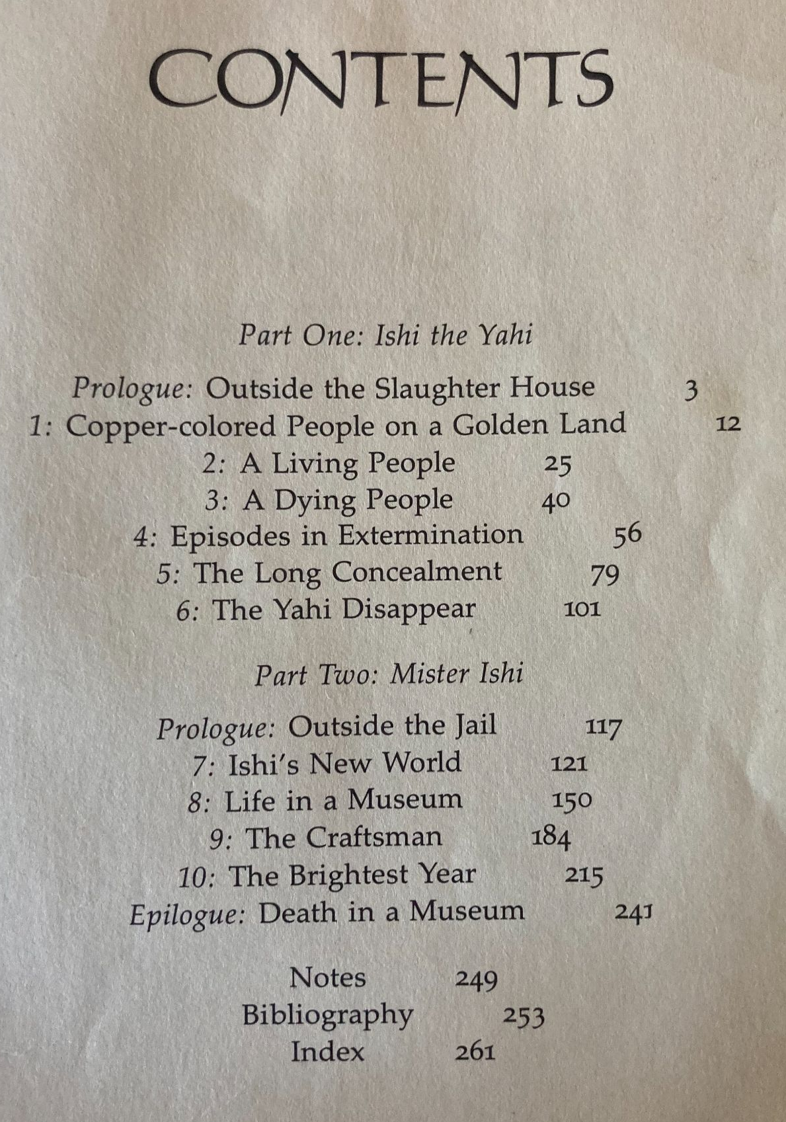
The Myth of Inevitable Extinction: Examples
Where do you notice the Myth of Inevitable Extinction in this example?
Ishi: In Two Worlds - Kroeber

Slide 16
Stations: Exploring Legalized Erasure
At each station, read the provided slide, and watch the attached video.
Take notes in the notetaker provided.

Slide 17
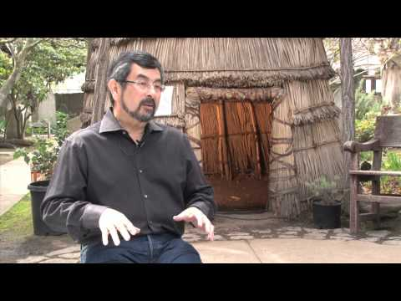
Station 1: California Mission System: 1769-1833
Video: CIMCC
Spanish missionaries built a series of 21 missions in California, with permission from the Catholic church
Native communities were forcibly placed in missions, where they were baptized, forced into labor camps, and were not allowed to leave
Languages, traditional clothing, and religious and marriage customs were forbidden. Thousands of Natives died from diseases, and over 80,000 Natives were baptized.
Native communities rebelled against the missions, and even burned some down (ie. Santa Barbara/Chumash Rebellion)
Notes:
Discovery Doctrine- . Columbus, during his travels, was granted permission by the Spanish monarchy to seize any land that was not already controlled by Christian rulers. Many letters and essays were exchanged between monarchs and the pope during this time, laying out the philosophy behind Christian conquest. These documents make up a legal doctrine through which Western nations rationalized the colonization of non christian lands, in often violent and forceful ways. The Discovery Doctrine was enshrined in US law during the supreme court case Johnson vs. McIntosh, in which Justice Marshal states that christians took their rightful dominion over the non christian “heathens”. This decision brought the idea of Indigenous sovereignty, the idea that Native people have the right to control their own communities and land) into question.
California Mission System Beginning in 1769, Spanish missionaries began building a series of 21 missions along the coast of California. Native communities were forcibly placed in missions, where they baptized, forced into labor camps, and were not allowed to leave the missions. Natives were forced to give up their languages, traditional dress, and religious and marriage customs. Thousands died from disease. In total, over 80k Natives were baptized. Even so, Native communities rebelled against the missions, and even burned some down.
California Gold Rush 1848-1860- After the Treaty of Hidalgo was signed in 1848, gold was discovered in California’s foothills. Over 90k settlers entered California in the first year and a half of the gold rush. Settlers were incredibly violent against Native people during this time, and their mining practices damaged the land, waterways,and cultural resources in the region. As miners build cities and ranches, many Native people were taken into servitude, experienced sexual and physical violence, and were forcibly removed from their land.
Act for the Governance and Protection of Indians- An act that legalized and incentivized the forced indentured servitude of Native people to white settler families. At the time, Native people did not have their citizenship, could not vote, and could not testify in court. The act led to increased violence against Native people, which eventually led to a state sanctioned genocide, where settlers were paid by the California government to murder Native people.
Unratified Treaties- California’s 18 Unratified Treaties are a series of agreements made between government officials and tribal leaders, that promised Native communities large swaths of reservation lands, based on the reservations in the plains. Out of concern for giving away land that could be economically lucrative, the federal government chose not the ratify the treaties, and so they never went into effect. Without notifying tribal leaders, tribes were left landless, destitute, and with little to no government protection.
Boarding school era-1870’s-1880’s (ended in California) 1978 (ended nationally) A nation-wide campaign to assimilate Native children into settler culture by removing them from their families, forbidding the use of their Native languages or cultures, and indoctrinating them into Christianity. Many children died or never returned home, and those who did were often culturally distanced from their families. The impacts of this system are still felt today, as cultural loss, and parenting challenges are still present. The system ended nationally in 1978 with the passing of the Indian Child Welfare Act, which gave Natives jurisdiction over issues related to child welfare.
Tribal termination- Called for the end of welfare assistance guaranteed to government-recognized Native peoples through the treaty process, and allowed for the private purchasing of once protected Native land to non Native individuals. When Native communities “accepted termination”, Native communities lost access to education, health care, and their property tax exemption status. Without this tax exempt status, many impoverished Native communities ended up defaulting on their tax payments. While the government originally saw this as an opportunity to take control of Native property, it quickly became a burden on resources. In the end, the government convinced 36 tribes to accept tribal termination, and was able to acquire 5k+ acres of Native land, leaving those tribal communities with little to no government protections.

Slide 18
Station 3: Boarding School Era, 1879-1973
Video: Vox
Thousands of Native children were forcibly removed from their families, forbidden the use of their Native languages or cultures, and converted to Christianity
Many children died or never returned home, and those who did were often culturally distanced from their families
Richard Pratt is famous for the quote “Kill the indian, save the man” in relation to this movement.

Slide 19
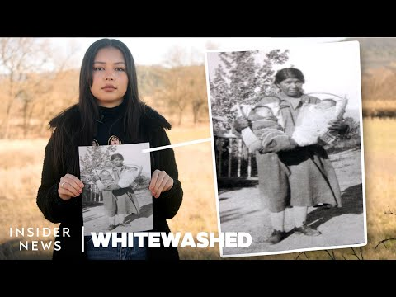
Station 3: Act for the Governance and Protection of Indians, 1850
Video: Insider News, featuring CIMCC
An act that legalized the indentured servitude of Native people to white settler families
At the time, Native people did not have their citizenship, could not vote, and could not testify in court
The act led to increased violence against Native people, which eventually led to a state sanctioned genocide, where settlers were paid by the California government to murder Native people.
A detailed history can be found in Murder State: California's Native American Genocide, 1846-1873, by Brendan C. Lindsay

Slide 20
Wrap Up:
How did settler communities in California attempt to erase the Native community?
Do the videos conflict with any history you have learned in school/museums/pop culture/etc.?
What most surprised you about the videos you watched? What do you wonder?

Slide 21
Standards and Takeaways
Key Takeaway: Native communities have been specifically targeted by settler communities, who sought to destroy them. Despite this, Native communities continue to exist and thrive.
Common Core:
CCSS.ELA-LITERACY.RI.9-10.7
Analyze various accounts of a subject told in different mediums (e.g., a person's life story in both print and multimedia), determining which details are emphasized in each account.
CCSS.ELA-LITERACY.RH.9-10.6
Compare the point of view of two or more authors for how they treat the same or similar topics, including which details they include and emphasize in their respective accounts.
CCSS.ELA-LITERACY.RH.9-10.1
Cite specific textual evidence to support analysis of primary and secondary sources, attending to such features as the date and origin of the information.
Seven Essential Understandings:
Essential Understanding 5 - There were many federal policies put into place throughout American history that have affected Indian people and still shape who they are today. Many of these policies conflicted with one another. Much of Indian history can be related through several major federal policy periods: Colonization/Colonial Period 1492 – 1800s; Treaty Period 1789 – 1871; Assimilation Period - Allotment and Boarding School 1879 – 1934; Tribal Reorganization Period 1934 – 1958; Termination and Relocation Period 1953 – 1971; Self-determination Period 1968 – Present.
Essential Understanding 6 - History is a story most often related through the subjective experience of the teller. With the inclusion of more and varied voices, histories are being rediscovered and revised. History told from an Indian perspective frequently conflicts with the stories mainstream historians tell.

Slide 22
Sources
An American Genocide by Benjamin Madley
Bureau of Indian Affairs
Native American Almanac
CIMCC: Education Videos
Vox News
Seeing Our Native Students, Redbud Resource Group
A Redbud Resource Group and CIMCC Collaboration

Slide 23
Sources
Slide 13:
https://tinangata.com/2019/06/01/james-cook-and-the-doctrine-of-discovery-5-things-to-know/
Slide 14:
https://californiamissionsfoundation.org/the-california-missions/
Slide 15:
http://mrflanderscalifornia.weebly.com/the-gold-rush.html
Slide 16:
https://www.pbs.org/wgbh/americanexperience/features/goldrush-act-for-government-and-protection-of-indians/
https://www.courts.ca.gov/documents/IB.pdf
Slide 17:
https://calindianhistory.org/california-unratified-treaties-map/
A Redbud Resource Group and CIMCC Collaboration

Slide 24
Sources
Slide 18:
https://www.aclunc.org/sites/goldchains/explore/native-american-slave-market.html
Slide 19:
http://collections.theautry.org/mwebcgi/mweb.exe?request=record;id=M207131;type=102
Slide 20:
https://www.history.com/topics/religion/california-missions
https://www.capitalgazette.com/column-san-diego-celebrates-250-years-with-an-inclusive-ceremony-story.html
Slide 21:
https://www.courts.ca.gov/documents/IB.pdf
https://billofrightsinstitute.org/activities/the-dawes-act-1887
Slide 22:
https://blogs.uoregon.edu/nativeamericanboardingschools/a-brief-history/
A Redbud Resource Group and CIMCC Collaboration

