Slide 1
From Erasure to Revitalization
Essential Questions:
How does erasure impact communities?
Who should tell our stories, and why does it matter?

Slide 2
Lesson 3: Historical Case Study: Ishi

Slide 3
Vocabulary
charged-filled with excitement, tension or emotion
tone-the general attitude communicated in a piece of writing
bias-prejudice; favoring one person or point of view more than others
point of view- a particular way of considering a matter; the position from which an event or topic is observed
implicit-suggested or assumed but not obvious or explicitly stated
anthropology- the academic study of cultures and their development over time
sources: Google Dictionary, dictionary.com, en.oxforddictionaries.com

Slide 4
Warm Up:
What does the word “civilization” mean? What does it mean to be civilized?
Is there only one way to be civilized?

Slide 5
What is Erasure?
Erasure is the act of removing something from a place.
Cultural erasure is when an entire community’s existence, culture, values, and voice, are absent or not recognized by the general public.

Slide 6
Cultural erasure can also happen when people from an outside culture misunderstands or
mischaracterizes another.

Slide 7
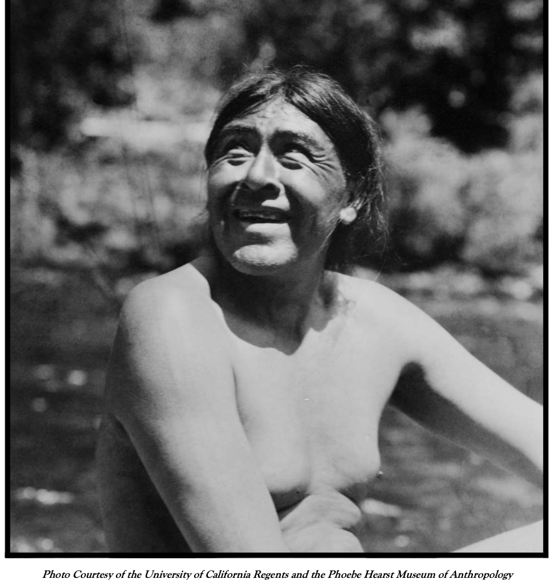
Cultural Erasure: Ishi
Directions:
Read pg. 3 of Ishi: A Story of Dignity and Hope
Questions:
What surprised you?
What questions do you have?

Slide 8
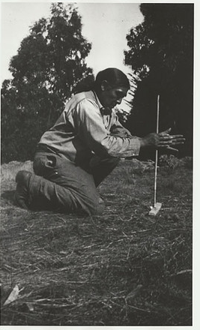
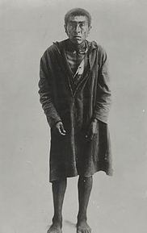
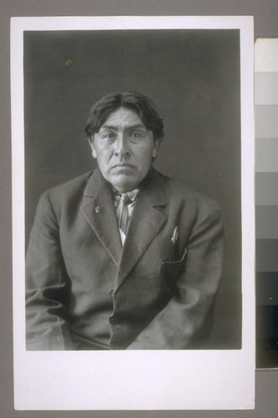
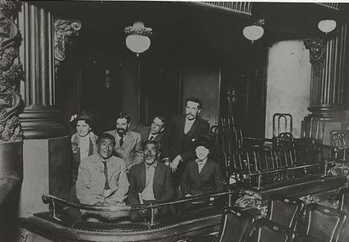
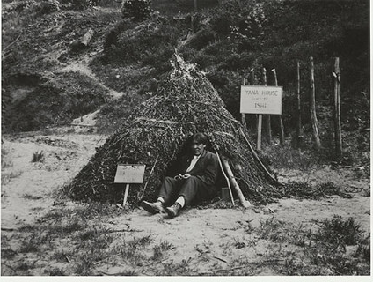
Photo timeline of Ishi
What do you notice about the series of photos?
What questions do you have?
Do you notice any signs of cultural erasure?
Ishi at the Orpheum Theatre,
San Francisco
View of Ishi and His house
“Ishi at the Time of his Capture”, 1911
“Ishi Drilling Fire”
Ishi, Full Face

Slide 9
Ishi: A Man of Dignity
Directions:
Read pg. 4-9 of Ishi: A Story of Dignity and Hope
Questions:
What surprised you?
What questions do you have?
Do you notice any signs of cultural erasure?

Slide 10
Who Tells the Native Story?
Directions: As you analyze each source on Ishi’s life, notice the following:
Who is the target audience of the source?
What is the tone of the example?
What message is the example sending about Native peoples?
What do you think the impact of the source is on Native and non Native communities?

Slide 11
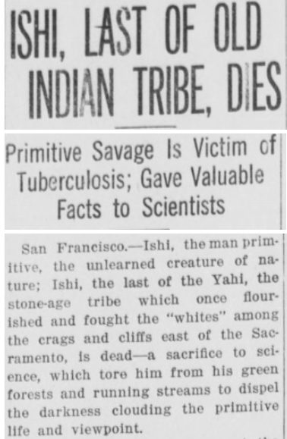
Combatting Erasure: Telling the Native Story
Example 1: California Newspaper
Sausalito News, Volume 32, Number 14 April 1, 1916
Notes:
http://cimcc.org/education-center/audio-visual-materials/

Slide 12

Combatting Erasure: Telling the Native Story
Example 2: Native community members/experts
California Indian Museum and Cultural Center, Ishi: A Story of Dignity, Hope and Courage
Notes:
http://cimcc.org/education-center/audio-visual-materials/

Slide 13
Combatting Erasure: Telling the Native Story
Example 3: California Newspaper Chico Record, May 19, 1914
ISHI RETURNS TO NATIVE WILD WITH MODERNS AS PUPILS
“Ishi. the one-time uncontaminated man, who has sojourned long at the Affiliated Colleges In one capacity and another, has returned to the wilds, says the Oakland Tribune. With the primitive man. into the unsettled space of Tehama county went two highly evolved moderns, men of science. The trio will hunt game, large and small, over the rock-strewn and brush-grown hills and through woodland regions once roamed by Ishi's ancestors when the lost tribe was numerous. In the wilds to which they have gone, Ishi is to become the instructor….
The two men of science aspire to become the peers of Ishi in the use of bow and arrow, the shaping of flints and the building of fires without the aid of the convenient little sulphur stick or patent lighter. Into the former haunts of his lost tribe, of which he supposed to be the sole surviving member. Ishi will lead the two students of wild life, whom he is to teach the ways of the world of ancient ages, and which Ishi’s people never outgrew. Just how primitive the two men of science expect to become has not been revealed.”
Notes:
http://cimcc.org/education-center/audio-visual-materials/

Slide 14
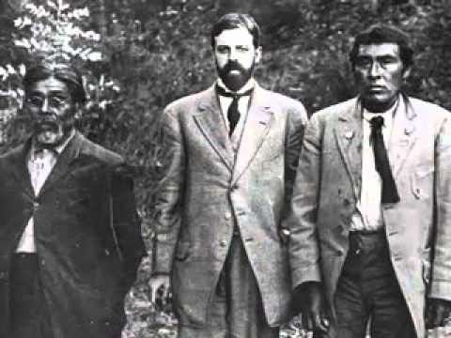
Combatting Erasure: Telling the Native Story
Example 4: Native community members/experts
California Indian Museum and Cultural Center, Ishi: A Story of Dignity, Hope and Courage
Notes:
http://cimcc.org/education-center/audio-visual-materials/

Slide 15
Synthesis:
    How can an author’s point of view change the message of a text?
    What are some differences in the way Native people describe Ishi, as opposed to the journalists? Why do you think these differences exist?
    Is it important for communities to be able to tell their own stories? Why or why not?

Slide 16
Extra: Ted Talk
https://www.youtube.com/watch?v=6JcKbN_GjCE

Slide 17
Wrap Up:
How can telling our own stories help combat
cultural erasure?

Slide 18
Standards and Takeaways
Key Takeaway: Native communities are diverse, modern, geographically spread out, and political in nature.
Common Core:
CCSS.ELA-LITERACY.RI.9-10.7
Analyze various accounts of a subject told in different mediums (e.g., a person's life story in both print and multimedia), determining which details are emphasized in each account.
CCSS.ELA-LITERACY.RH.9-10.6
Compare the point of view of two or more authors for how they treat the same or similar topics, including which details they include and emphasize in their respective accounts.
Seven Essential Understandings:
Essential Understanding 5 - There were many federal policies put into place throughout American history that have affected Indian people and still shape who they are today. Many of these policies conflicted with one another. Much of Indian history can be related through several major federal policy periods: Colonization/Colonial Period 1492 – 1800s; Treaty Period 1789 – 1871; Assimilation Period - Allotment and Boarding School 1879 – 1934; Tribal Reorganization Period 1934 – 1958; Termination and Relocation Period 1953 – 1971; Self-determination Period 1968 – Present.
Essential Understanding 6 - History is a story most often related through the subjective experience of the teller. With the inclusion of more and varied voices, histories are being rediscovered and revised. History told from an Indian perspective frequently conflicts with the stories mainstream historians tell.

Slide 19

Sources
Native American Almanac
Ishi in Two Worlds, Theodora Kroeber
UCR: Center for Bibliographical Studies and Research
Sausalito News, Volume 32, Number 14, April 1916, Edition 02
Chico Record, Number 118, 19 May 1914
CIMCC Exhibit: http://cimcc.org/education-center/audio-visual-materials/
Ted Talk: https://www.youtube.com/watch?v=6JcKbN_GjCE
Calisphere.org- Photo Archives
A Redbud Resource Group and CIMCC Collaboration

