Slide 1
From Erasure to Revitalization
Essential Questions:
How does erasure impact communities?
Who should tell our stories, and why does it matter?

Slide 2
Lesson #1: Intro to Native Identity

Slide 3
Vocabulary
Federal recognition: Tribes that have federal recognition are recognized as sovereign, independent governing bodies. Federal recognition affords tribes the ability to set laws and regulations that apply to their land, however, tribes are still subject to certain oversights by the U.S. federal government.
Treaty: A formal, legally binding agreement that has been ratified.
Erasure is the act of removing something from a place.
Cultural erasure: When an entire community’s existence, culture, values, and voice, are absent or not recognized by the general public.

Slide 4
Explore: What do you already know about Native culture?
Do you notice any patterns in your sources?
Write what you already know in the circle.
Native American
Write your sources on the outside of your circle.

Slide 5
Activity: Big Poster Conversation

Slide 6
Activity: Big Poster Conversation
At each station, you will explore a different element of Native identity.
Every station has a large poster with reflection questions in
the center.
Each station is also assigned a video, which you will watch independently.
Without speaking, you will observe the items on the poster, and answer the reflection questions on the poster.
Read your classmates comments and questions, and respond to your classmates through writing.

Slide 7
Example: BIG Poster Conversation
Reflection Questions:
What did you learn about Native people based on this source?
What do you wonder about? What questions do you have?
“Between building a career and managing a life-style Kira faced many challenges and adversities. Despite this she became a well-known Native American tattoo artist. She not only did it, but excelled. Nothing really changes unless you make the change “Don’t quit”, she says “People are going to push you down, you just have to keep going, keep doing it.” When asking her what Sin Miedo meant to her, she responded by saying “Dive into anything you can, be fearless and get back up.”
Notes:
There is a video in the center (in this case the video is an image with a quote), along with reflection questions.

Slide 8
Example: BIG Poster Conversation (activity)
To be honest, I never pictured Native people being tattoo artists. There doesn’t seem like there is a lot of diversity in this area.
I notice that she really tries to ignore people who bring her down.
Reflection Questions:
What did you learn about Native people based on this source?
What do you wonder about? What questions do you have?
“Between building a career and managing a life-style Kira faced many challenges and adversities. Despite this she became a well-known Native American tattoo artist. She not only did it, but excelled. Nothing really changes unless you make the change “Don’t quit”, she says “People are going to push you down, you just have to keep going, keep doing it.” When asking her what Sin Miedo meant to her, she responded by saying “Dive into anything you can, be fearless and get back up.”
I wonder if her art is influenced by her culture?
Right. She also notes that it is our personal responsibility to work hard to pursue our dreams.
Though I wonder if she received support from anyone she trusts?It can be hard as a young person to overcome challenges alone.
I see that she also mentions a Spanish phrase. I wonder if Native American people can also speak Spanish?
Notes:
As students engage with the video, they answer the reflection questions on the poster, and respond to one another.

Slide 9
Big Poster Stations:
Station 1: Political Identity
Station 2: Appearance/Race
Station 3: Physical Existence
Station 4: Location
Station 5: Contemporary Existence/ Assimilation

Slide 10
Warm Up: Revisited
Based on your Big Poster Station work,
what do you now know about Native American identity?
Are there any differences between your most recently added sources, compared to your original sources?

Slide 11
What is Erasure?
If you are surprised by how much you don’t know about Native people, you are not alone!
Native people have experienced extreme cultural erasure
for centuries.
Erasure is the act of removing something from a place.
Cultural erasure is when an entire community’s existence, culture, values, and voice, are absent or not recognized by the general public.

Slide 12
Personal Reflection
Do you see examples of people who look and behave like you in your community?
What are some examples? Consider: Art, politics, jobs, movies, music, etc.
Do you think that people who share a similar identity/culture to you experience erasure in any way? How so? Where?

Slide 13
Native American
Identity: An Overview

Slide 14
Native Community Profile: USA
573
Indian
Country

Slide 15
Native Community Profile: USA
7 out of 10
Indian
Country
NYC
Natives live in urban areas
New York City has the highest number of Native residents

Slide 16
Native Community Profile: California
110
Oakland
Federally Recognized Tribes
Konkow
Wintu
Rumsen
90 Native languages
Biggest Native community
Notes:
https://cla.berkeley.edu/california-languages.php

Slide 17
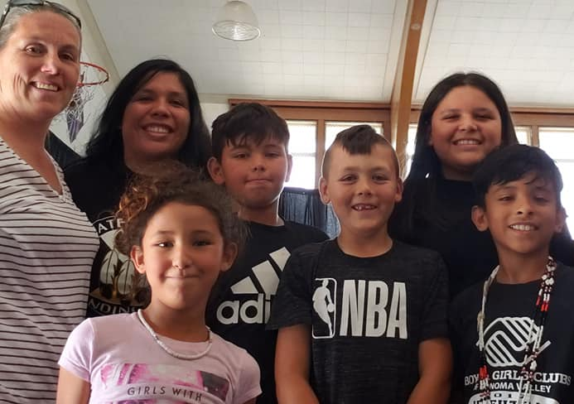
Appearance
Native people have diverse physical appearances.
Indigenous communities around the world by have different skin, eye, and hair color, depending on their location.
Native communities have different style and appearance norms, depending on culture.
Some Native people wear traditional fashion, some do not.
Photos: Pomo youth, adults, and elders in the local community
Notes:
Quote from pg. 14 SONS
Community photographs from gatherings

Slide 18
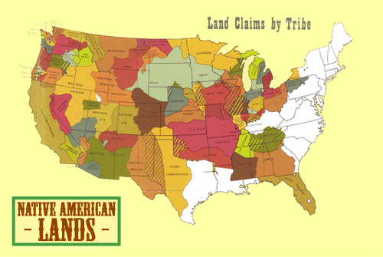
Location
5 billion acres of land has been taken from Native communities.
Combined native holdings in green, non-native land in white. (Sam B. Hillard / Sunisup)

Slide 19
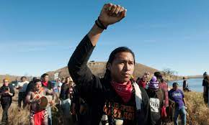
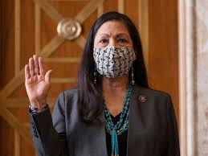
Contemporary Existence
There are many wonderful Native American organizations providing insight into the good work being done for the Native Community.
Providing
Opportunities
Teaching
Wellness
Raising
Awareness
Standing up for Community
Protester at Standing Rock
Deb Haaland, Secretary of
the Interior.
CIMCC
Community Classes
Rutherford Falls, sitcom.

Slide 20
Wrap Up:
How does the information you learned in this lesson enhance or change your understanding of Native peoples?
What questions do you have after this lesson?

Slide 21
Standards
Common Core:
CCSS.ELA-LITERACY.RI.9-10.7
Analyze various accounts of a subject told in different mediums (e.g., a person's life story in both print and multimedia), determining which details are emphasized in each account.
CCSS.ELA-LITERACY.RH.9-10.6
Compare the point of view of two or more authors for how they treat the same or similar topics, including which details they include and emphasize in their respective accounts.
Seven Essential Understandings:
Essential Understanding 1 - There is great diversity among the tribal nations in their languages, cultures, histories and governments. Each Nation has a distinct and unique cultural heritage that contributes to modern U.S.
Essential Understanding 2 - There is great diversity among individual American Indians as identity is developed, defined and redefined by entities, organizations and people. A continuum of Indian identity, unique to each individual, ranges from assimilated to traditional. There is no generic American Indian.
Essential Understanding 4 - Reservations are lands that have been reserved by the tribes for their own use through treaties, statutes, and executive orders and were not “given” to them. The principle that land should be acquired from the Indians only through their consent with treaties involved three assumptions: 1) Both parties to treaties were sovereign powers. 2) Indian tribes had some form of transferable title to the land. 3) Acquisition of Indian lands was solely a government matter not to be left to individual colonists.

Slide 22
Sources:
https://www.bia.gov/frequently-asked-questions
https://news.berkeley.edu/2021/01/26/kroeber-hall-unnamed/
https://youtu.be/siMal6QVblE
https://www.loc.gov/resource/calbk.051
https://youtu.be/Ikq1XOZTXeI
https://youtu.be/qYgZ1Pxw6aI
A Redbud Resource Group and CIMCC Collaboration

