Slide 1
From Erasure to Revitalization
Essential Questions:
How does erasure impact communities?
Who should tell our stories, and why does it matter?

Slide 2
Lesson 7: Cultural Visibility Project

Slide 3
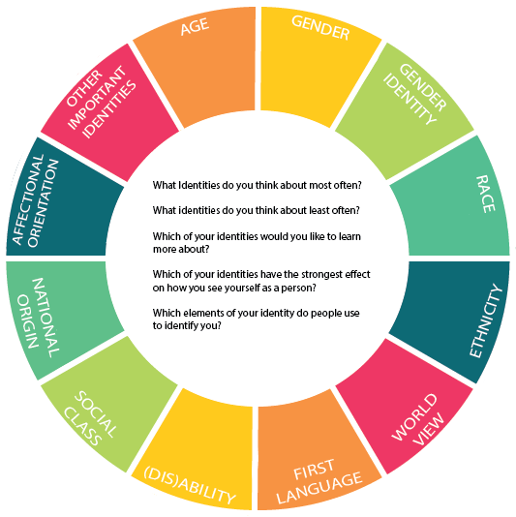
Warm Up:
Complete the identity wheel using the template provided.

Slide 4
Vocabulary
Reclaim: retrieve or recover (something previously lost, given, or paid); obtain the
return of.
Resilience: the capacity to recover quickly from difficulties; toughness.
Revitalize: imbue (something) with new life and vitality.

Slide 5
Cultural Visibility Project
Step 1: Choosing your Focus
Step 2: Personal Culture Data Collection
Step 3: Data Sorting
Step 4: Data Analysis
Step 5: Visibility Examples
Step 6: Self Reflection
During this project, you will assess the amount of cultural visibility your community experiences, and determine ways to enhance that visibility.

Slide 6
Project Share

Slide 7
Wrap Up:
As a class, discuss the essential questions explored in this unit:
What is erasure and how does it impact communities?
Why is it important for communities to tell their own stories?

Slide 8
Sources
Slide 4:
Identity Wheel, Cultural Tree, Redbud Resource Group
A Redbud Resource Group and CIMCC Collaboration

