Slide 1
From Erasure to Revitalization
Essential Questions:
How does erasure impact communities?
Who should tell our stories, and why does it matter?

Slide 2
Lesson 5: Repairing Relationship
to Place

Slide 3
Vocabulary
Repatriation: the process of returning an asset, an item of symbolic value, or a person—voluntarily or forcibly—to its owner or their place of origin or citizenship
Reclaim: retrieve or recover (something previously lost, given, or paid); obtain the
return of.
Resilience: the capacity to recover quickly from difficulties; toughness.
Revitalize: imbue (something) with new life and vitality.

Slide 4
Warm Up:
Have you ever had something stolen from you?
What did it feel like?
When someone has had something stolen from them, what is the best way to right the wrong they have experienced?

Slide 5
Relationship to Land: Native Perspectives
Recommended Videos:
Source 1:
Kashia Pomo Relationship with Ocean
Source 2:
Kashia Pomo Return Home
How do these Kashia Pomo community members relate to their ancestral land?
Where are your ancestors from (generally)? What is your relationship like to your ancestral homeland?

Slide 6
Erasure of Native peoples happens all around us.
Even in our park system.

Slide 7
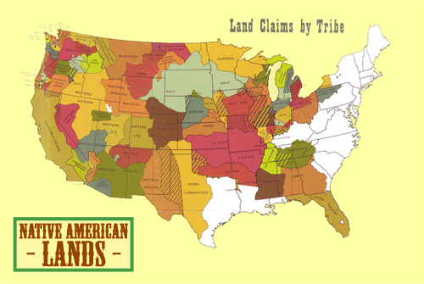
Since the formation of the U.S. Government, Native communities have lost 1.5
billion acres of land.
Native people were forced into small reservations, where they had little access to their traditional foods, and were/are separated from the origins of many cultural and spiritual practices.
Combined native holdings in green, non-native land in white. (Sam B. Hillard / Sunisup)

Slide 8
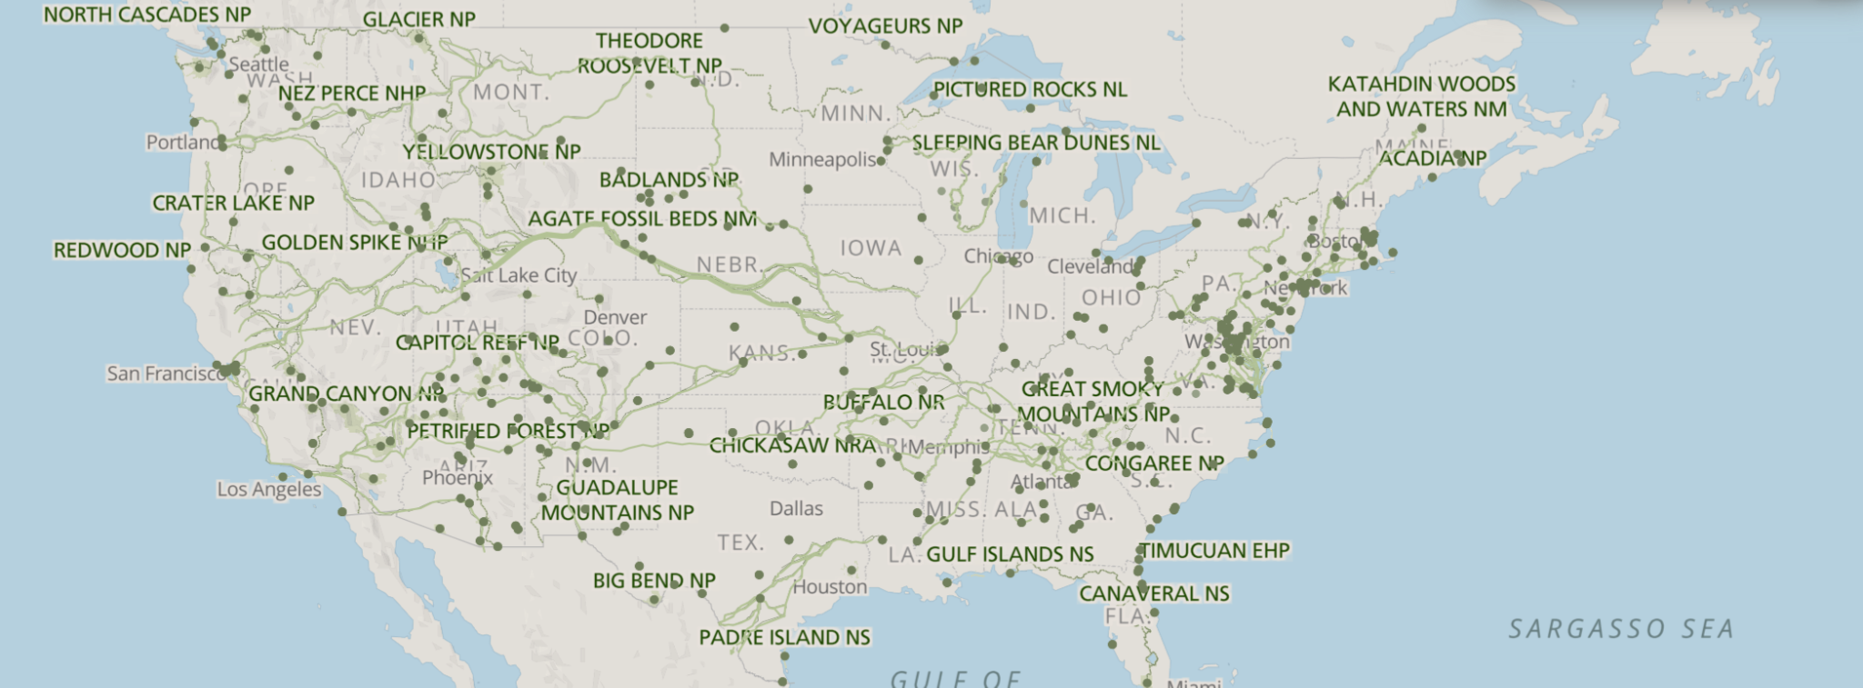
Erasure in our Parks
https://www.nps.gov/planyourvisit/maps.htm
The National Park System in the US spans 52.2 million acres of land. Native people lived on this land since Time Immemorial, until they were forcibly removed, making space for the parks.

Slide 9
Erasure in Our Parks
Article Link: https://www.theatlantic.com/magazine/archive/2021/05/return-the-national-parks-to-the-tribes/618395/
Podcast Link: https://www.theatlantic.com/podcasts/archive/2021/04/national-parks-native-americans/618574/?preview=nt6XmOPb2Hxv5v6NBAbyAWTG4c0
Poster 1: Culture
Poster 2: Physical location
Directions: On your post its, collect evidence of the following:
Cultural impact of national parks on Native people
Impact on the location of Native people
Ecological impact of the National Parks, from a Native lens
How to improve Native visibility in the parks for the future’
Place post its on the correct poster.
Poster 3: Ecology
Poster 4: Combatting Erasure, Increasing Visibility

Slide 10
Wrap Up:
How would returning land to Native communities support the health and visibility of the community? What challenges do you think might come up during the process of returning land to Natives?

Slide 11
Standards and Takeaways
Key Takeaway: Native communities are diverse, modern, geographically spread out, and political in nature.
Common Core:
CCSS.ELA-LITERACY.RI.9-10.7
Analyze various accounts of a subject told in different mediums (e.g., a person's life story in both print and multimedia), determining which details are emphasized in each account.
CCSS.ELA-LITERACY.RH.9-10.6
Compare the point of view of two or more authors for how they treat the same or similar topics, including which details they include and emphasize in their respective accounts.
CCSS.ELA-LITERACY.RH.9-10.2
Determine the central ideas or information of a primary or secondary source; provide an accurate summary of how key events or ideas develop over the course of the text.
Seven Essential Understandings:
Essential Understanding 3 - The ideologies of Native traditional beliefs and spirituality persist into modern day life as tribal cultures, traditions, and languages are still practiced by many American Indian people and are incorporated into how tribes govern and manage their affairs. Additionally, each tribe has its own oral histories, which are as valid as written histories. These histories pre-date European contact, i.e., the “discovery” of North America.
Essential Understanding 5 - There were many federal policies put into place throughout American history that have affected Indian people and still shape who they are today. Many of these policies conflicted with one another. Much of Indian history can be related through several major federal policy periods: Colonization/Colonial Period 1492 – 1800s; Treaty Period 1789 – 1871; Assimilation Period - Allotment and Boarding School 1879 – 1934; Tribal Reorganization Period 1934 – 1958; Termination and Relocation Period 1953 – 1971; Self-determination Period 1968 – Present.
Essential Understanding 6 - History is a story most often related through the subjective experience of the teller. With the inclusion of more and varied voices, histories are being rediscovered and revised. History told from an Indian perspective frequently conflicts with the stories mainstream historians tell.

Slide 12
Sources
Source 1:
Kashia Pomo Relationship with Ocean
Source 2:
Kashia Pomo Return Home
Article:
https://www.theatlantic.com/magazine/archive/2021/05/return-the-national-parks-to-the-tribes/618395/
Podcast: https://www.theatlantic.com/podcasts/archive/2021/04/national-parks-native-americans/618574/?preview=nt6XmOPb2Hxv5v6NBAbyAWTG4c0
A Redbud Resource Group and CIMCC Collaboration

