Slide 1
From Erasure to Revitalization
Essential Questions:
How does erasure impact communities?
Who should tell our stories, and why does it matter?

Slide 2
Lesson 6: Cultural Revitalization

Slide 3
Vocabulary
Reclaim: retrieve or recover (something previously lost, given, or paid); obtain the
return of.
Resilience: the capacity to recover quickly from difficulties; toughness.
Revitalize: imbue (something) with new life and vitality.

Slide 4
Warm Up:
Describe a time that you, or someone you know, had to change something about themselves in order to fit in.
Analyze the lyrics to Raye Zaragoza’s song “Change Your Name”
What does it tell us about erasure?
What does it tell us about resilience?
Can you relate to the song at all? How so?

Slide 5
What is Erasure?
Erasure is the act of removing something from a place.
Cultural erasure is when an entire community’s existence, culture, values, and voice, are absent or not recognized by the general public.

Slide 6
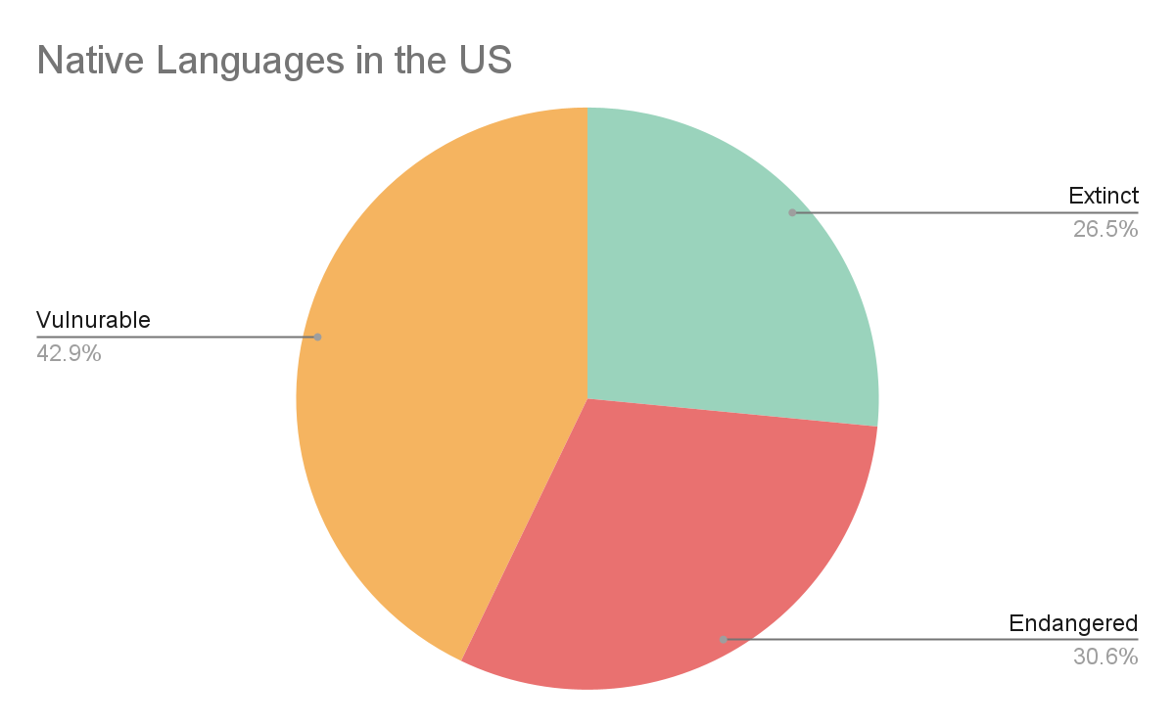
The Impact of Erasure: Cultural Loss Data Analysis
What do you notice about the data?
What impacts might language loss have on the community?
Source: Office for the Administration of Children and Families

Slide 7
What is Revitalization?
Revitalize: to restore energy, life, and vitality to something
Cultural revitalization: When communities from a shared culture restore a culture practice that was previously lossed or dormant. This could mean bringing back a language, a spiritual practice, a food, a type of music, etc.

Slide 8
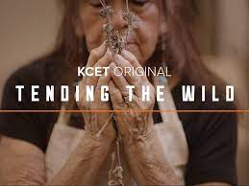
“Tending The Wild” Cultural Revitalization Examples
Choose a video on a topic that interests you and answer the following:
1. What episode did you choose?
2. How does the episode show an example of cultural revitalization?
3. How does the work of the people featured in the episode counter “historical erasure” or the “Myth of Inevitable Extinction”?
4. What are some of the ongoing challenges and barriers to cultural revitalization?
5. How can cultural revitalization support all people?
Episodes: LINK

Slide 9
Wrap Up:
As a class, discuss the essential questions explored in this unit:
1. What is one way that Native people are reclaiming their cultures and
increasing visibility?
2. How can cultural visibility support all people?

Slide 10
Standards and Takeaways
Common Core:
CCSS.ELA-LITERACY.RI.9-10.7
Analyze various accounts of a subject told in different mediums (e.g., a person's life story in both print and multimedia), determining which details are emphasized in each account.
CCSS.ELA-LITERACY.RH.9-10.6
Compare the point of view of two or more authors for how they treat the same or similar topics, including which details they include and emphasize in their respective accounts.
CCSS.ELA-LITERACY.RH.9-10.2
Determine the central ideas or information of a primary or secondary source; provide an accurate summary of how key events or ideas develop over the course of the text.
Seven Essential Understandings:
Essential Understanding 2 - There is great diversity among individual American Indians as identity is developed, defined and redefined by entities, organizations and people. A continuum of Indian identity, unique to each individual, ranges from assimilated to traditional. There is no generic American Indian.
Essential Understanding 3 - The ideologies of Native traditional beliefs and spirituality persist into modern day life as tribal cultures, traditions, and languages are still practiced by many American Indian people and are incorporated into how tribes govern and manage their affairs. Additionally, each tribe has its own oral histories, which are as valid as written histories. These histories pre-date European contact, i.e., the “discovery” of North America.
Essential Understanding 6 - History is a story most often related through the subjective experience of the teller. With the inclusion of more and varied voices, histories are being rediscovered and revised. History told from an Indian perspective frequently conflicts with the stories mainstream historians tell.

Slide 11
Sources
https://www.kcet.org/shows/tending-the-wild
https://www.acf.hhs.gov/ana/preserving-native-languages-article
“Change Your Name” by Raye Zaragoza
A Redbud Resource Group and CIMCC Collaboration

